Slide 1


Network Data Analysis
Topic 1: Networks in the real world
Albert Meroño-Peñuela
Jacopo de Berardinis

Slide 2

What is a graph?
A graph, or network, is a set of items (nodes or vertices) connected by their relations (edges or links).
Networks are present in the everyday life of all people.
Social: Friends & family, society
Transport: Rail, road, public transport
Information: World economy
Biology: Brain cells
Communication: Internet
Consciously or not, we use networks and their properties as a universal language for describing complex data.
Networks from science, nature, and technology are more similar than one would expect.
Shared vocabulary between fields, including computer science, social science, physics, economics, statistics, biology.

Slide 3
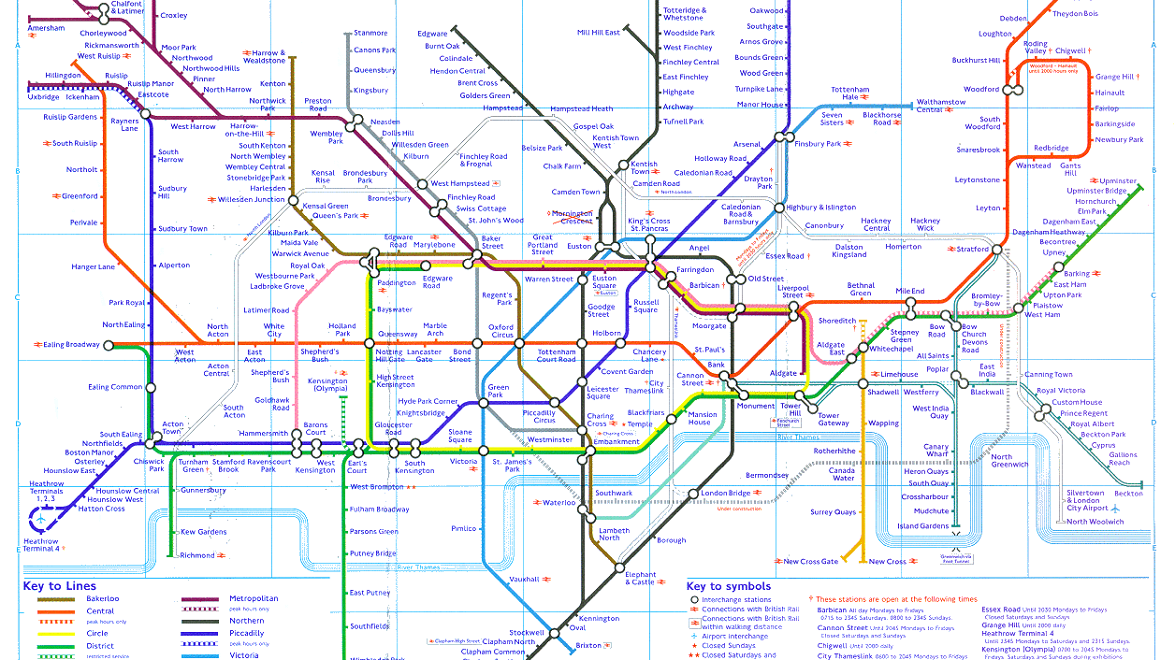

Slide 4
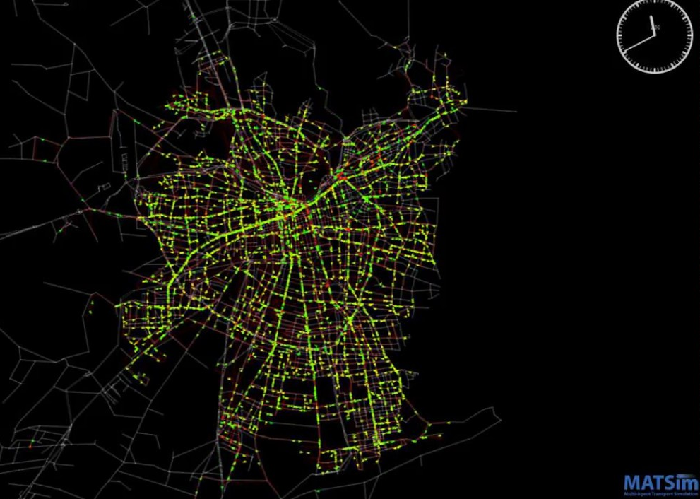
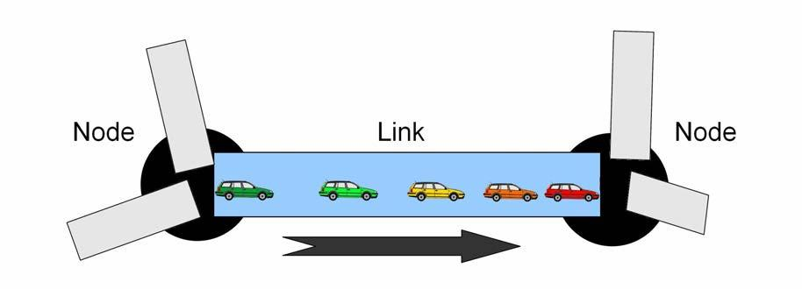
Agent-based modelling of traffic

Slide 5
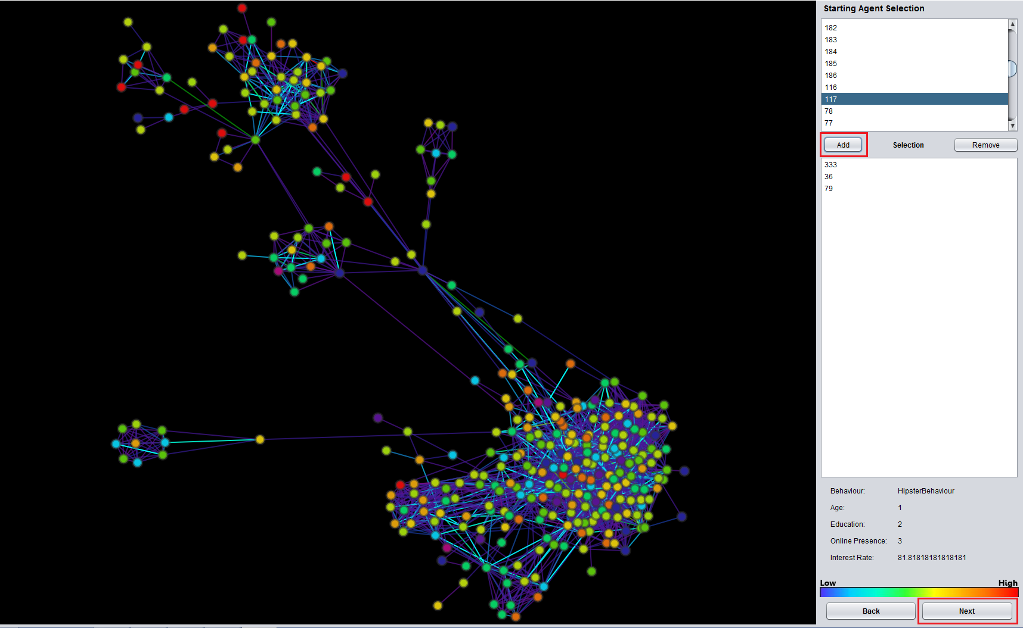
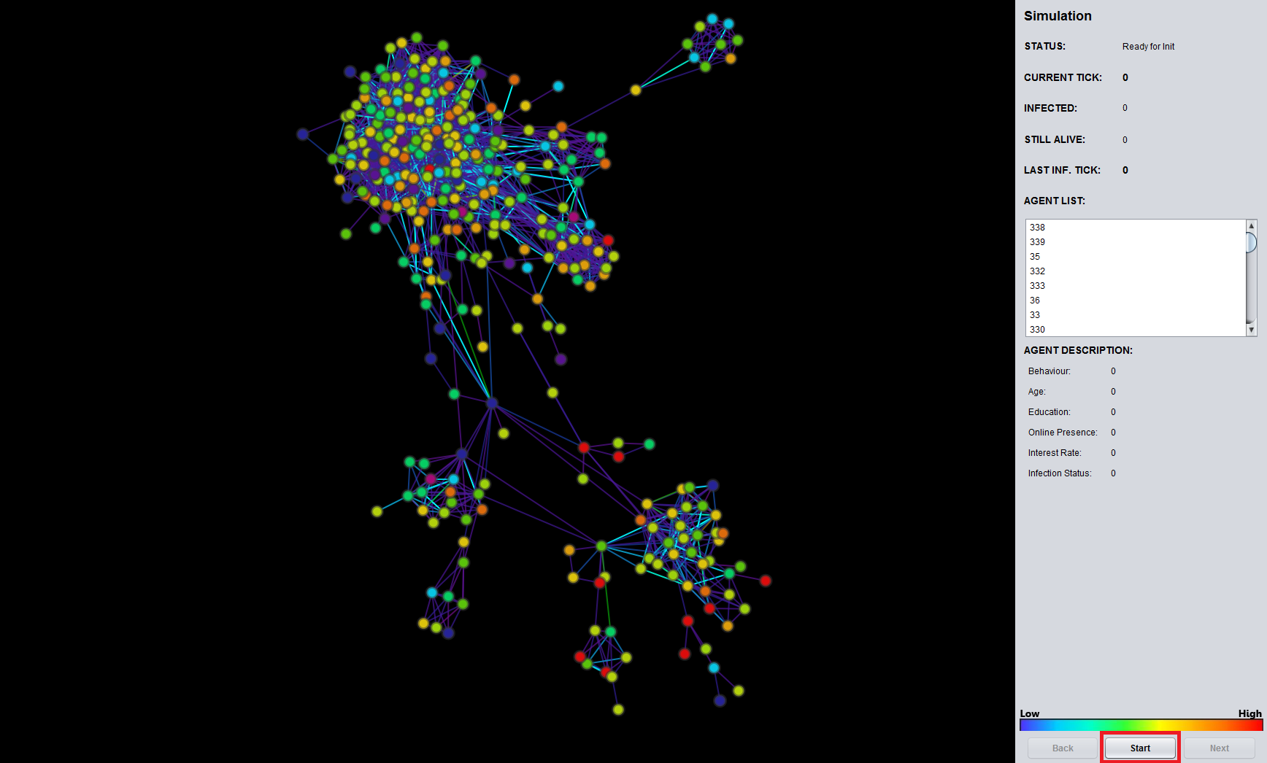
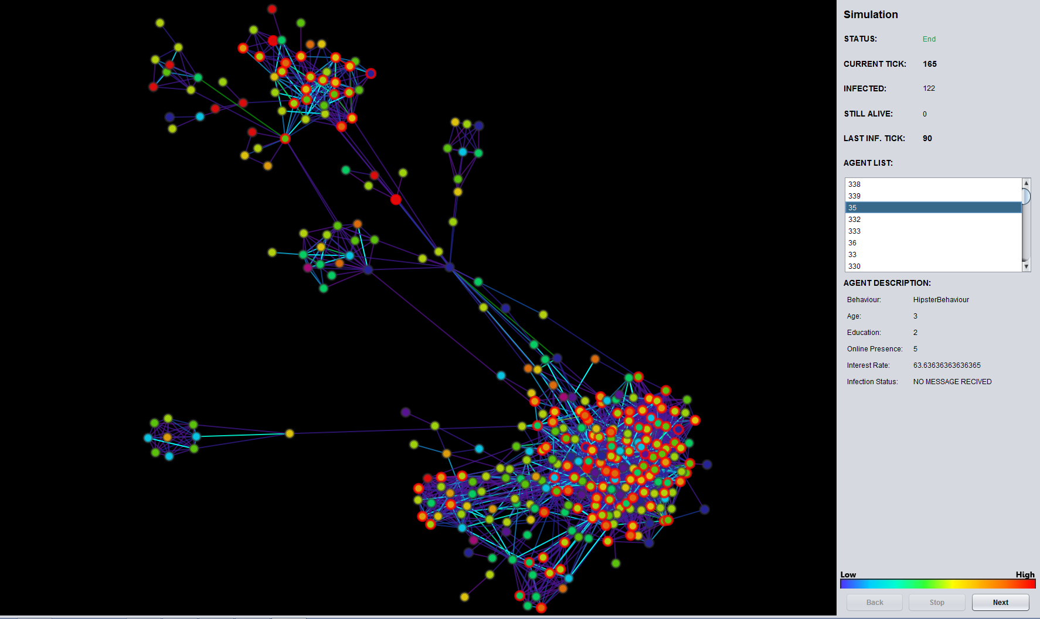
Information spread in social networks

Slide 6
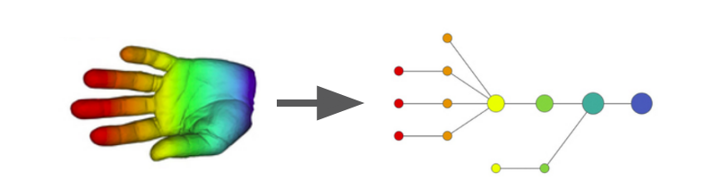
Topological Data Analysis: looking at “the shape of data”

Slide 7
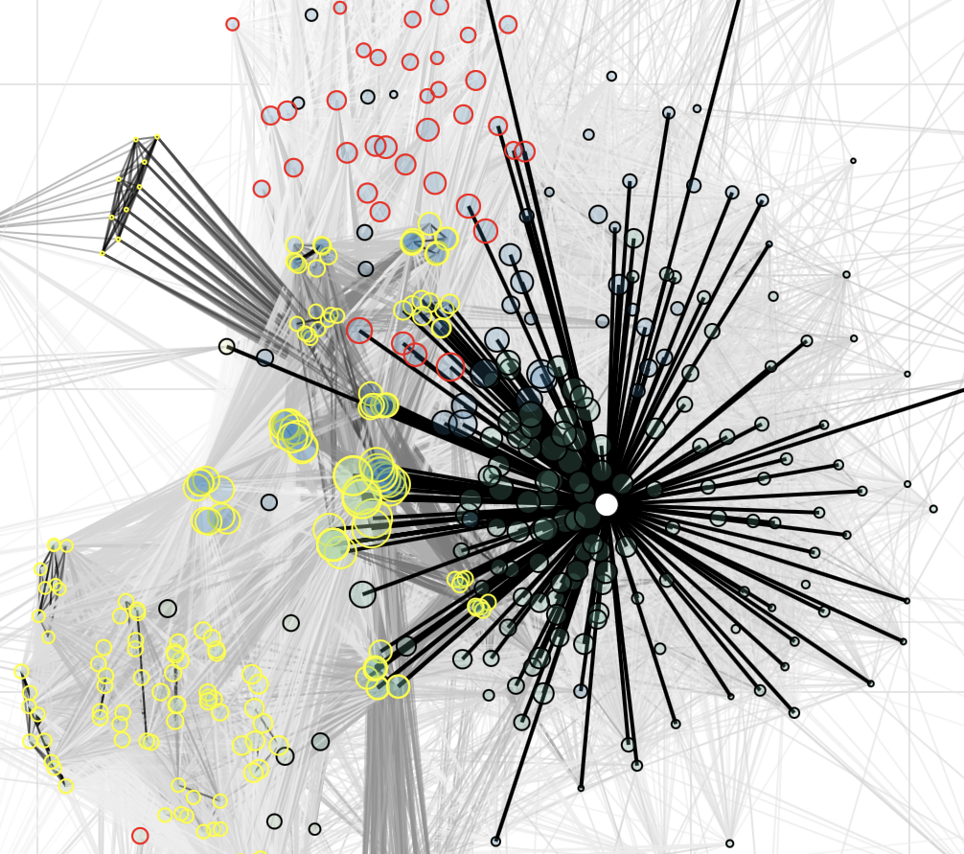

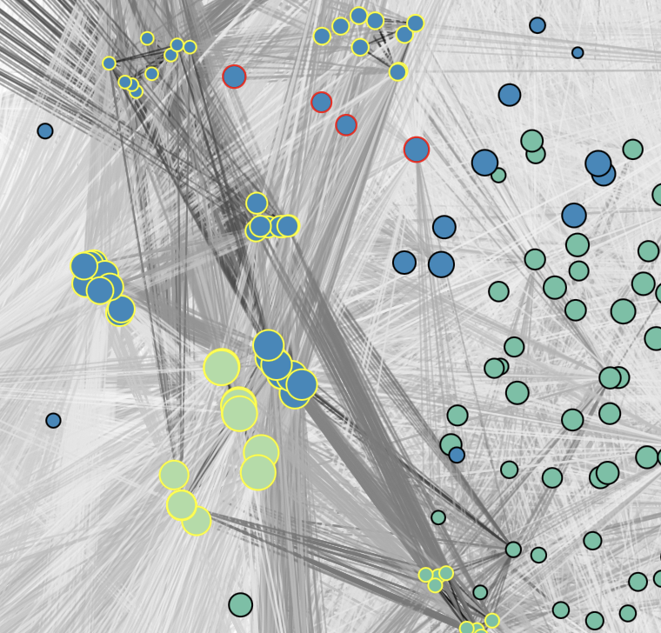
The Harmonic Network
Nodes are tracks, Edges express harmonic similarities

Slide 8
Networks in the world
Social and economic networks: People or groups with contacts or interactions between them
Friendship networks, business relations between companies, intermarriages between families, labour markets
Example: To understand disease spread, you need to know social networks.
Questions: Degree of connectedness, small-world effects
Information networks: Connections of information objects
Academic paper citations, network of webpages with links to others
Example: To understand news dissemination, you need to know information networks.
Questions: Ranking, navigation
Spatial networks: Networks where nodes and edges have location
Road networks, migration destinations, river systems
Example: To understand whether crime is distributed according to space, you need to know street networks
Questions: Network-based clustering or correlations

Slide 9
Study of networks
Empirical: Study network data to find organisational principles
How do we measure and quantify networks?
Mathematical models: Graph theory, statistical models
Models allow us to understand behaviors and distinguish surprising from expected phenomena
Algorithms for analysing graphs
Hard computational challenges!
Historical study of networks with mathematical graph theory

Slide 10

Graphs and their properties

Slide 11
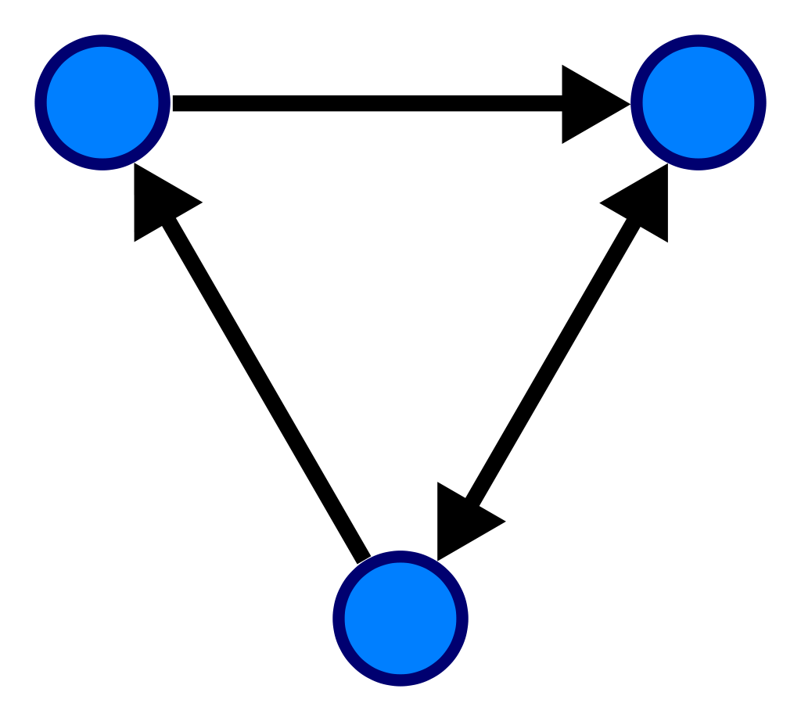
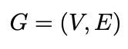
Graphs
A graph is a mathematical representation of a network, and the basic data structure for analysing network data
A graph consists of a set of nodes and a set of edges

Slide 12
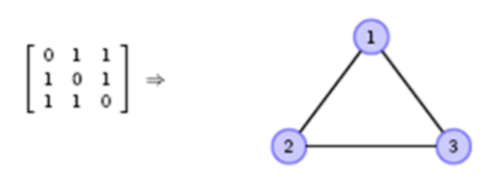
Graph representations
Adjacency matrix: the graph is represented by a tuple (N, g), where N = {1, 2, ..., n} is a set of n nodes, and g is a n x n matrix (the adjacency matrix). Each element of the matrix g_{ij} has value 1 if there is an edge between nodes i and j, and 0 if there is not.

Slide 13
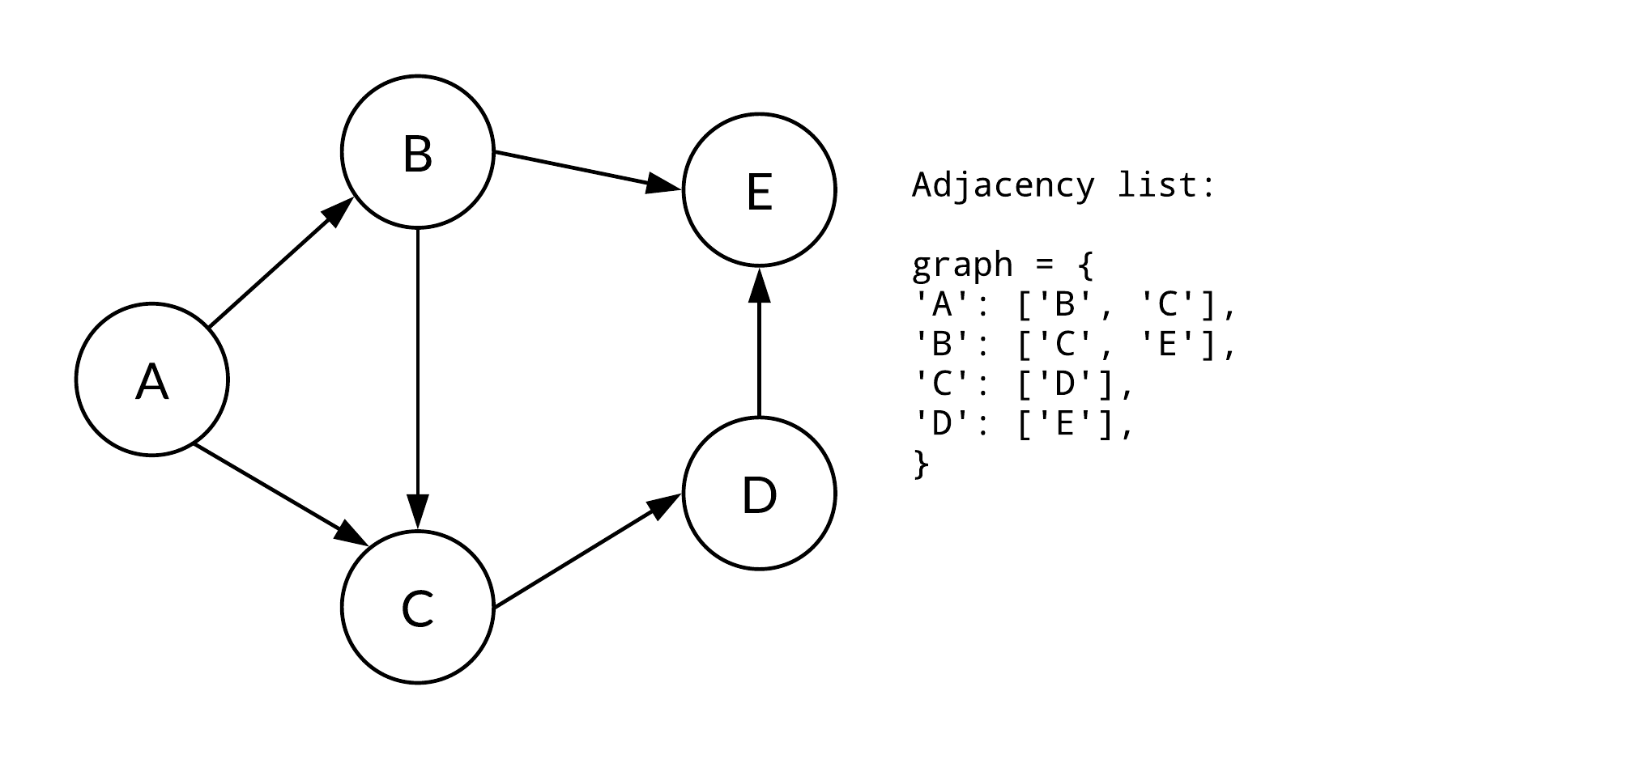
Graph representations
Adjacency list: represented by a tuple (N, E), where N = {1, 2, ..., n} is a set of n nodes as before and E is a set of edges, where each edge is a tuple of the two nodes connected by the edge, e.g. E = {(1, 2), (1, 3), (2, 3)}.

Slide 14
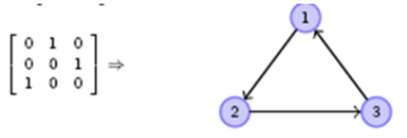
Directed and undirected graphs
Directed graph: each edge has a direction, going from the source node to the target (or sink) node. For example, in the directed graph with edges E = {(1, 2), (1, 3), (2, 3)}, there is an edge from node 1 (the source) to node 2 (the target) but no edge from node 2 to node 1
Undirected graph: edges have no direction, e.g. in an undirected graph with edges E = {(1, 2), (1, 3), (2, 3)}, there is a connection between nodes 1 and 2 but no notion of whether that goes ‘from’ or ‘to’ each node
Underlying undirected graph of a directed graph is the undirected graph with the same nodes and edges but ignoring any direction

Slide 15
Graph walks
Graph walk: a series of connected edges representing a journey through the graph from one node via other nodes to a final node following the edges. If the graph is directed, then the walk must follow the direction of the edges
Graph path: a graph walk where no node is repeated except possibly the start node if it is the same as the end node

Slide 16
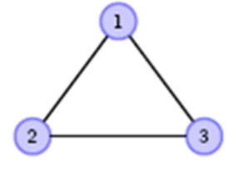
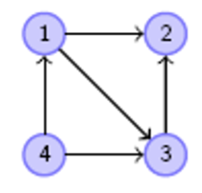
Neighbourhood and degree
The neighbourhood of a node is the set of nodes it is connected to
The degree of a node is the number of edges of that node
For undirected graphs, the degree of a node is the number of edges that involve that node, i.e. the size of its neighbourhood
For directed graphs, the in-degree of a node is the number of edges for which the node is the target, while the out-degree of a node is the number of edges for which the node is the source

Slide 17
Properties of graphs
Degree distribution: P(k) = N(k)/n probability of a random node having degree k, for a graph of n nodes and N(k) is the number of nodes in the graph with degree k
Path length: number of edges that the path contains. The shortest path between two nodes is the path with the shortest length
Distance between two nodes: length of the shortest path between them
Diameter: longest distance between nodes in a connected graph.

Slide 18
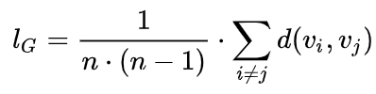
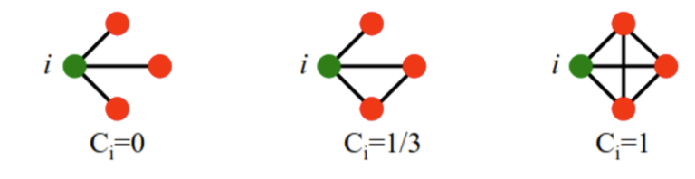
Properties of graphs
Average path length: mean average distance between any two nodes in the network
Clustering coefficient of a node is the proportion of its neighbours that are connected to each other. C_{i} = e / m is the clustering coefficient of node I (m = total possible edges between neighbours; e = actual number of edges between neighbours)
Average clustering: mean average of the clustering coefficients of its nodes

Slide 19
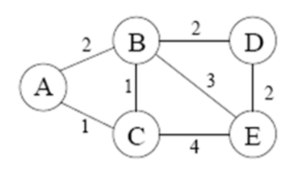
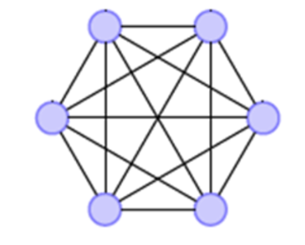
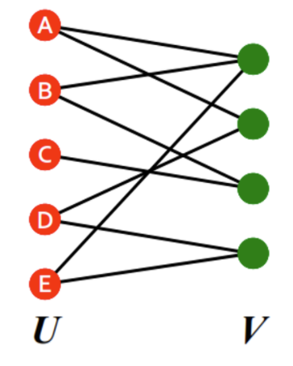
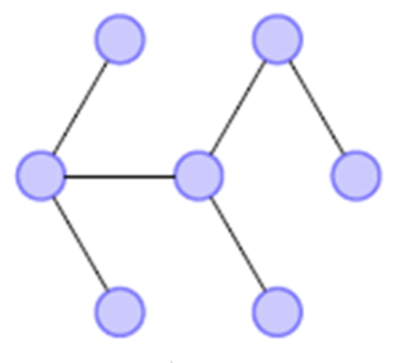
Types of graphs
Weighted graph: labelled graph where edges have numeric labels, e.g. weights
Complete graph: graph where every node is connected to every other node (maximum number of edges, i.e. n(n - 1) / 2)
Bipartite graph: nodes can be divided into two disjoint sets U and V, where every edge connects a node in U to a node in V
Tree: connected undirected graph (with n – 1 edges)

Slide 20
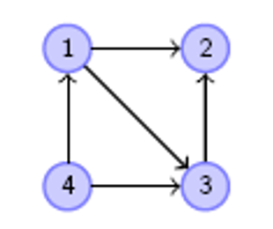
Tutorial Exercise 1
In the out-degree distribution P(k), what is the value of P(2)?

Slide 21
Tutorial Exercise 2
What is the diameter of the underlying undirected graph?

Slide 22
Tutorial Exercise 3
What is the average path length of the underlying undirected graph?

Slide 23
Tutorial Exercise 4
What is the clustering coefficient of node 1 in the underlying undirected graph?

Slide 24
Tutorial Exercise 5
How many of the following sequences could be returned by a depth-first search from node 4?
[4, 1, 2, 3] [4, 1, 3, 2]
[4, 2, 1, 3] [4, 2, 3, 1]
[4, 3, 1, 2] [4, 3, 2, 1]

Slide 25

Discussion points
Imagine we are going to analyse how the housing market in a city functions.
What networks could be relevant to consider in analysing this topic?
What kinds of graph, as studied in this lesson, represent these networks?
What might the properties studied in this lesson, such as diameter or cluster coefficient, applied to these networks tell you about the city?

Slide 26
Origins of graph theory

Slide 27
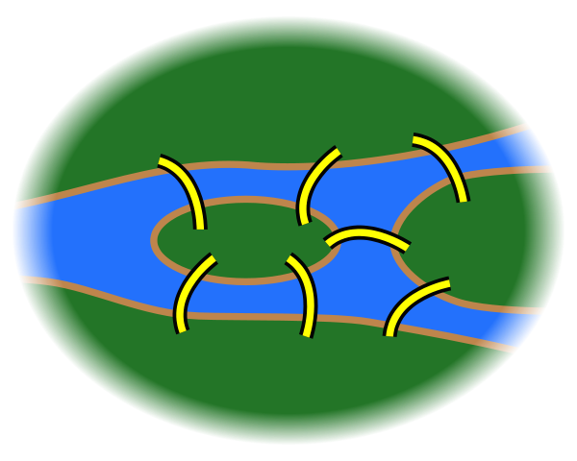
Königsberg bridge problem
The city of Königsberg in Prussia (now Kaliningrad, Russia) was set on both sides of the Pregel River
two large islands which were connected to each other and the mainland by seven bridges.
The problem was to find a walk through the city that would cross each bridge once and only once.
The islands could not be reached other than by the bridges, and every bridge must have been crossed completely every time.
Euler proved that the problem has no solution
North bank
Central island
Other island
South bank

Slide 28
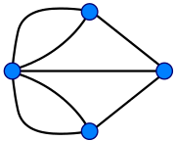

Königsberg bridge problem
…
…

Slide 29
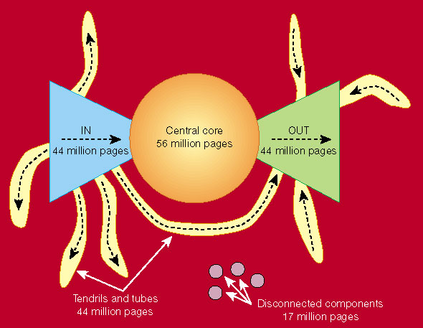
Web as a Graph
Web as a directed graph:
Nodes = web pages & Edges = hyperlinks
Directed version of the Web graph:
Largest SCC: 28% of the nodes (56 M)
Taking a random node v
Out(v) ≈ 50%
In(v) ≈ 50%
“The web is a bowtie”, Nature, vol. 405, May 2000

Slide 30
Weekly discussion topic
All students: post your thoughts on the module’s discussion forum in KEATS
Imagine we are going to analyse how the housing market in a city functions.
What networks could be relevant to consider in analysing this topic?
What kinds of graph, as studied in this lesson, represent these networks?
What might the properties studied in this lesson, such as diameter or cluster coefficient, applied to these networks tell you about the city?
What public data sets can you find that provide you with data on the networks you’ve identified?
Who might hold private network data sets that would also be valuable in this analysis?

